Slide 1


CGB1201 – JAVA PROGRAMMING
PROJECT REVIEW-2
Department of Computer Science and Engineering
Academic Year: 2024 – 2025 (Odd Semester)
Register Number : 2303811710421151
Name : SIVA SURUYA S
Year : 2nd
Semester : III
Section : AN
Date : 23/11/2024

Slide 2
TITLE OF THE PROJECT
Online Job Portal

Slide 3
AGENDA
Abstract
Introduction
Java Programming – Concepts Used
Proposed Architecture
Module Description
Result and Discussion
Conclusion

Slide 4
ABSTRACT
The Online Job Portal is a system that connects job seekers with employers.
Job seekers can search and apply for jobs based on their skills, while employers can post job vacancies and manage applications.
The system aims to streamline the job application process, improving efficiency for both parties.

Slide 5
INTRODUCTION
The Online Job Portal simplifies the recruitment process by providing a platform for job seekers to find suitable jobs and for employers to manage job applications.
This Java-based solution enhances job matching and application management, benefiting both job seekers and employers.

Slide 6
JAVA PROGRAMMING - CONCEPTS USED
Object-Oriented Programming (OOP): Classes like Job and Employee are used to model real-world entities
Data Structure: ArrayList is used to store Job seekers,employers and Job posting.
Encapusaltion & Abstraction: Data is securely managed within classes, and internal processes are abstracted for simplicity.

Slide 7
PROPOSED ARCHITECTURE
User interface
User details
Job vacancy
Registration
The job vacancy which is in the job portal
The registration successfully/ unsuccessful
Name
Email I’d
Degree
Job type

Slide 8
MODULE DESCRIPTION
User Detail: Manages and stores job seekers' and employers' personal and professional details.
Job Vacancy :Enables employers to post job vacancies and job seekers to view or apply for jobs.
Job Registration: Allows job seekers and employers to register on the portal.
Exit Module:Handles the termination of the program when the user chooses to exit.

Slide 9
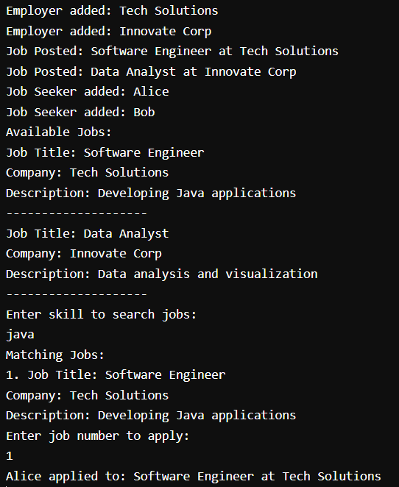
RESULTS AND DISCUSSION

Slide 10
CONCLUSION
The Online Job Portal successfully demonstrates job matching and application management using Java. It simplifies the recruitment process and is extendable for larger-scale use.

Slide 11
THANK YOU

